Slide 1
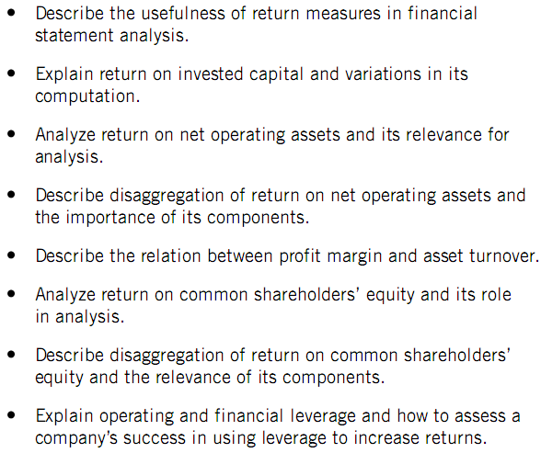
ROIC & PROFITABILITY ANALYSIS

Slide 2
Return on Invested Capital
Importance of Joint Analysis
• Joint analysis is where one measure is
assessed relative to another
• Return on invested capital (ROIC) or Return on Investment (ROI) is an important joint analysis

Slide 3
Return on Invested Capital
ROI allows us to compare companies on their success with invested capital, assess a company’s return relative to its capital investment risk, and compare the return on invested capital to returns of alternative investments.
ROI compares a company’s income, or other performance measure, to a company’s level and source of financing
ROI determines a company’s ability to succeed, attract financing, repay creditors and reward owners

Slide 4
Components of ROI
Return on invested capital is defined as:
Income
Invested Capital

Slide 5
Components of ROI
Invested Capital Defined
• No universal measure from which to compute rate of return
• Different measures of invested capital reflect users’ different perspectives
Common Measures:
• Net Operating Assets
• Stockholders’ Equity

Slide 6
Net Operating Assets (NOA)
• Operating activities are the most long-lasting and relevant for the determination of stock price.
• Operating activities are the core activities of the company
What items in the income statement are reflected as operating activities?
How about the balance sheet?

Slide 7
Net Operating Assets (NOA)
NOA
• Operating assets are comprised of total assets less financial assets.
•Operating liabilities are comprised of total liabilities less interest-bearing debt.
•Operating assets less operating liabilities yields net operating assets (NOA).

Slide 8
Components of ROI
Net Operating Profit after Tax
(NOPAT)
Net operating Profit after tax (NOPAT) equals revenue less operating expenses such as cost of goods sold, SG&A expenses, and taxes.

Slide 9
Components of ROI
Common Equity Capital
• Our analytical perspective is that of common equity holders.
• Common equity is equal to total shareholders’ equity less preferred stock.
• Common equity can alternatively be defined as equal to total assets less debt and preferred stock
• The amount of equity is a function of the degree to which the company is financed with debt .

Slide 10
Components of ROI
Net income
• Net income is impacted by the amount of interest expense that the company must pay on its debts.
• The return on common equity captures both the returns on net operating assets (RNOA) discussed above and the effects of financial leverage.

Slide 11
Computing Invested Capital
•Usually computed using average capital available to the company for the period.
•Add beginning and ending year invested capital and divide by 2
•Or average interim amounts — quarterly or monthly

Slide 12
Return on Net Operating Assets -- RNOA
NOPAT
(Beginning NOA + Ending NOA) / 2
Where
NOPAT = Operating income x (1- tax rate)
NOA = net operating assets

Slide 13
Return on Net Operating Assets -- RNOA
• Operating assets include cash, accounts receivable, inventories, prepaid expenses, deferred tax assets, property, plant and equipment (PPE), and long term investments related to strategic acquisitions
• Operating liabilities include accounts payable, accrued expenses, deferred income tax liabilities…

Slide 14
Return on Net Operating Assets -- RNOA
• Non-operating assets include investments in marketable securities, nonstrategic equity investments, and investments in discontinued operations prior to sale
• Non-operating liabilities include bonds and other long-term interest-bearing liabilities, and the noncurrent portion of capitalized leases, dividends payable.

Slide 15
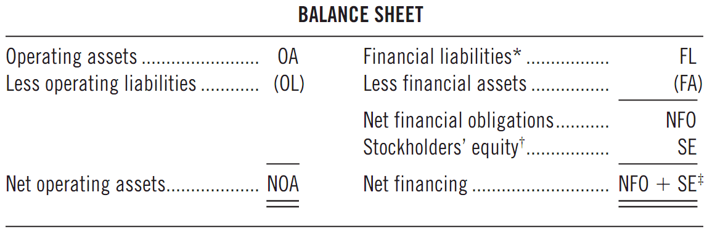
Return on Net Operating Assets -- RNOA

Slide 16

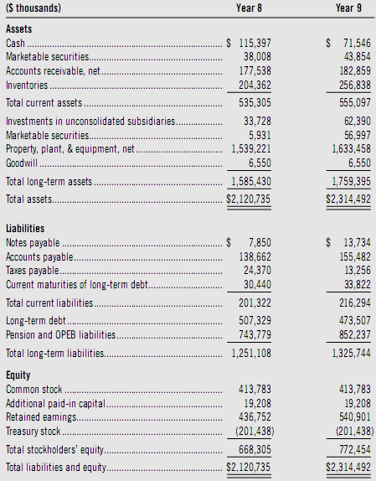

Slide 17
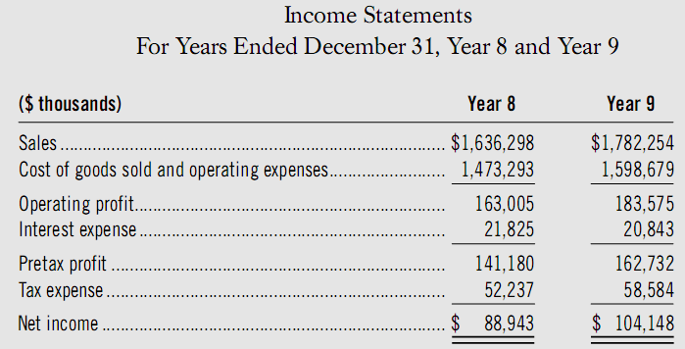
Net Operating Profit after Tax (NOPAT)

Slide 18
Return on Common Equity -- ROCE
Net income - Preferred dividends
(Beginning equity + Ending equity) / 2
Where
Equity is stockholder’s equity less preferred stock

Slide 19
Disaggregating RNOA
Return on operating assets =
Operating Profit margin x Operating Asset turnover
Operating Profit margin (NOPAT margin): measures a company’s operating profitability relative to sales
Operating Asset turnover (NOA turnover): measures a company’s effectiveness in generating sales from net operating assets

Slide 20

Effect of Operating Leverage on RNOA
OA = operating assets
OLLEV = operating liabilities leverage ratio
(avg. operating liabilities / avg. NOA)

Slide 21
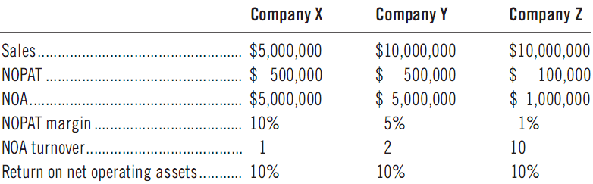
Relation between Profit Margin and Asset Turnover

Slide 22
Relation between Profit Margin and Asset Turnover
Profit margin and asset turnover are interdependent
Profit margin is a function of sales and operating expenses.
Sales equals selling price multiplied by units sold.
Turnover is also a function of sales
(sales/assets)

Slide 23
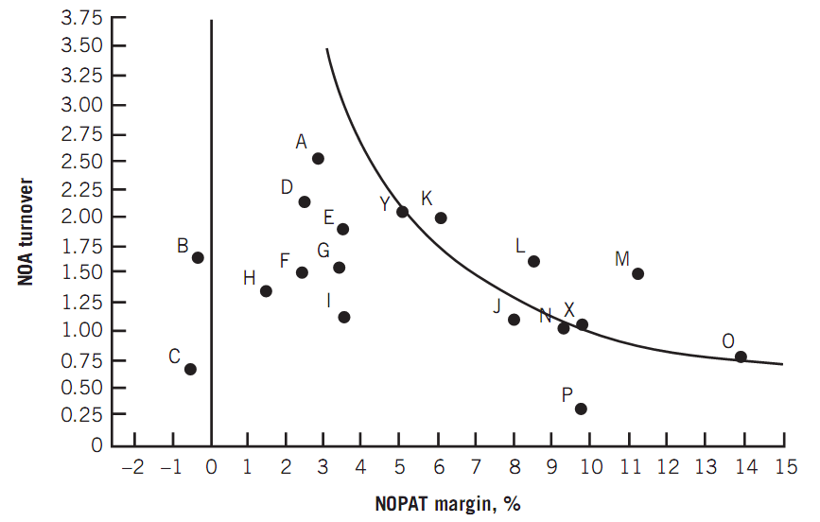
Relation between Profit Margin and Asset Turnover

Slide 24
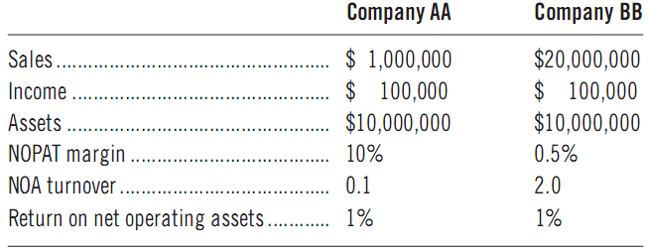
Relation between Profit Margin and Asset Turnover

Slide 25
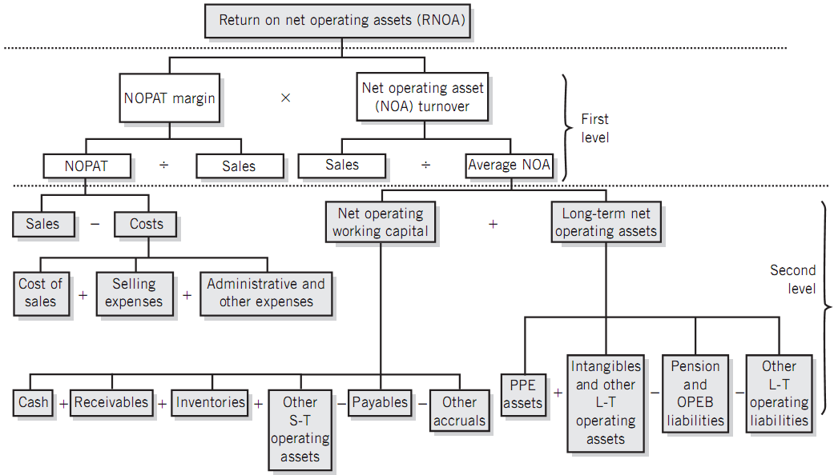
Disaggregating RNOA

Slide 26


Disaggregating Profit Margin

Slide 27
Gross Profit Analysis
Gross Profit
Revenues less cost of sales – frequently reported as a percent (gross profit percent) – computed as gross profit divided by sales
Gross profit covers all costs, finance essential future-directed discretionary expenditures
Gross profits vary across industries
Major drivers of gross profit
+Increase (decrease) in sales volume
+Increase (decrease) in per-unit selling price
+Increase (decrease) in cost per unit

Slide 28
Gross Profit Analysis
Gross Profit
Strategic activities to remedy or improve gross profit
The reason for a decrease in gross profit is a decline in unit selling prices
The reason for a decrease in gross profit is an increase in unit costs
Direct attention to potential distortions arising from accounting methods (Especially inventories and depreciation accounting)

Slide 29
Gross Profit Analysis
Selling Expenses
Distinguish variable and fixed components
When selling expenses as a percentage of revenues show an increase, we should focus attention on the increase in generating the associated increase in revenues
Sales promotion expenses - year-to-year trends
General and Administrative Expenses
Fixed; Direct attention at both the trend in these expenses and the percentage of revenues they consume

Slide 30
Disaggregation of Asset Turnover
Sales
average net operating assets
• Asset turnover measures the intensity with which companies utilize assets
• The most relevant measure of asset utilization is sales
• Further evaluation of components changes in turnover rates for individual assets can be useful in a company analysis
Caution:
• Increase in turnover rates by lowering our investment in assets might be counterproductive
• Our investment in assets must be optimized, not necessarily minimized.

Slide 31
Disaggregation of Asset Turnover
Accounts Receivable turnover
Average collection period
Inventories turnover
Average inventory days outstanding
Accounts Payable turnover
Average payable days outstanding
Long-term Operating Asset turnover
Net operating working capital turnover

Slide 32
Disaggregation of Asset Turnover
The relative productivity of long-term operating assets, on average
Differ across industries
The ways of Increasing in long-term operating asset turnover
Net operating working capital is equal to operating current assets less operating current liabilities
The higher net working capital turnover, the better

Slide 33
Return on Common Equity Analysis
Net income - Preferred dividends
(Beginning equity + Ending equity) / 2
Where
Equity is stockholder’s equity less preferred stock

Slide 34
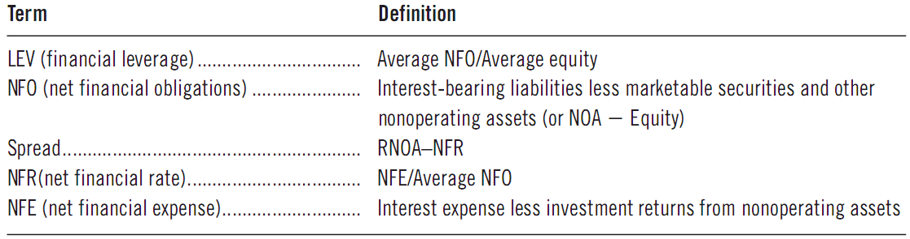
Disaggregating ROCE

Slide 35
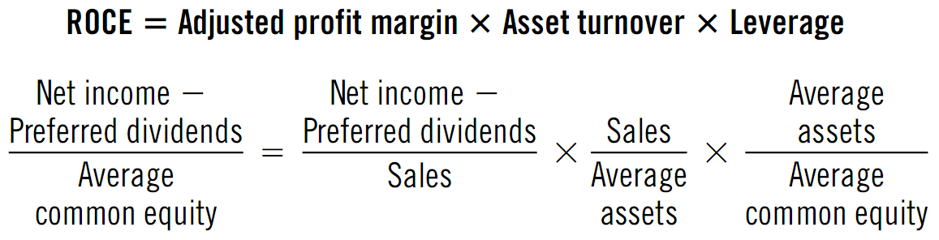
Alternate View of ROCE Disaggregation

Slide 36
Disaggregation of ROCE
The vast majority of companies provide goods and services to customers as their primary business
Operating activities have the most pronounced and long-lasting effects on company value
Increasing debt increases the risk of default

Slide 37
Additional analysis
The degree of financial leverage is generally under control of the company
Spread is a function of the interest rate on debt and investment returns
The resulting increase from an increased spread in ROCE should not be given as much weight in our analysis as will an increase resulting from more persistent operating returns.

Slide 38
Analyzing Return on Common Equity-ROCE
Assessing Equity Growth
• Assess common equity growth rate through earnings retention
• Assume earnings retention and a constant dividend payout

Slide 39
Analyzing Return on Common Equity-ROCE
Assessing Equity Growth
Assumes internal growth depends on both earnings retention and return earned on the earnings retained

